Slide 1
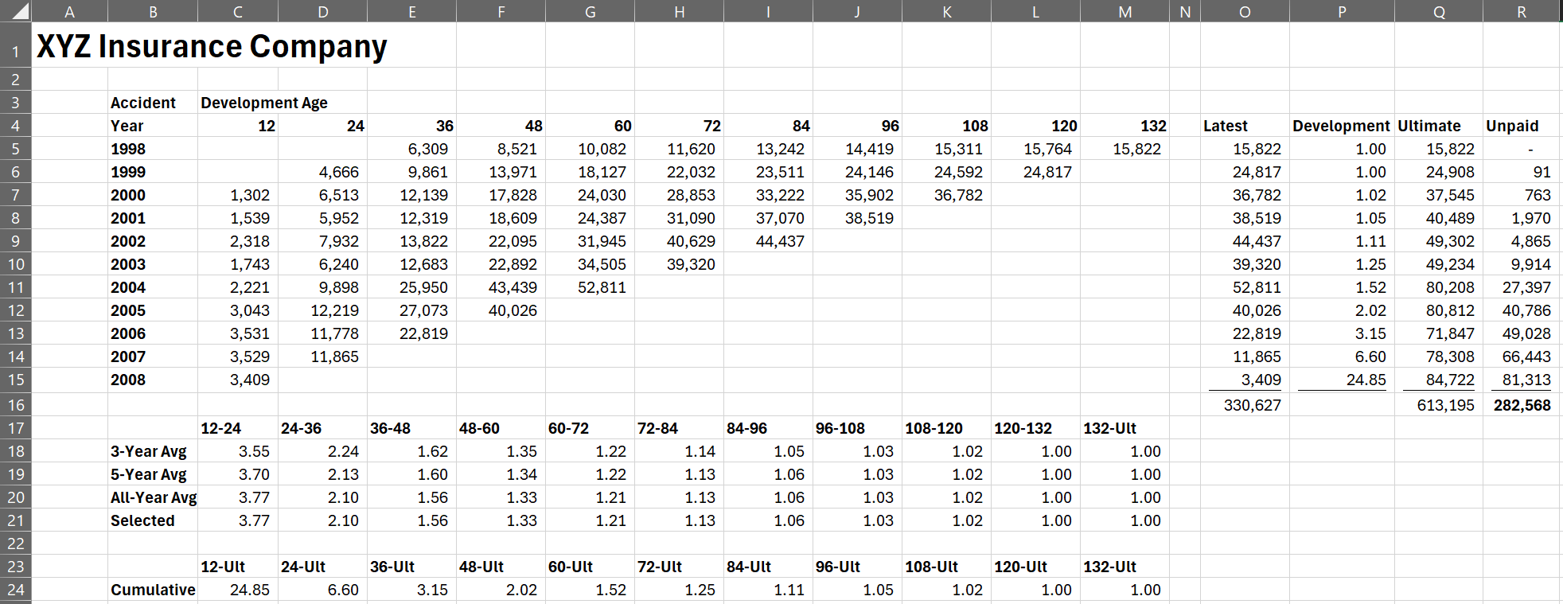
A Basic Lag Study
Excel
Triangle
Model
Development

Slide 2
Excel affords:
Transparency of calculations
Camera-ready output
What updates are necessary to:
Add another year to our triangle?
Try a different model besides the basic?
Scenario test various development factor selection?

Slide 3
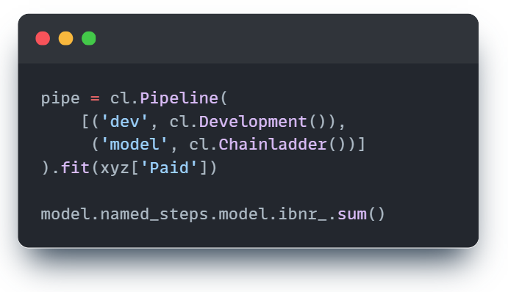
A Basic Lag Study
Python
What updates are necessary to:
Add another year to our triangle? No need to manage shape of a triangle (rows and columns)
Try a different model besides the basic? Swap out different battle-tested estimators
Scenario test various development factor selection?
Loop through various assumptions and store key results.

Slide 4
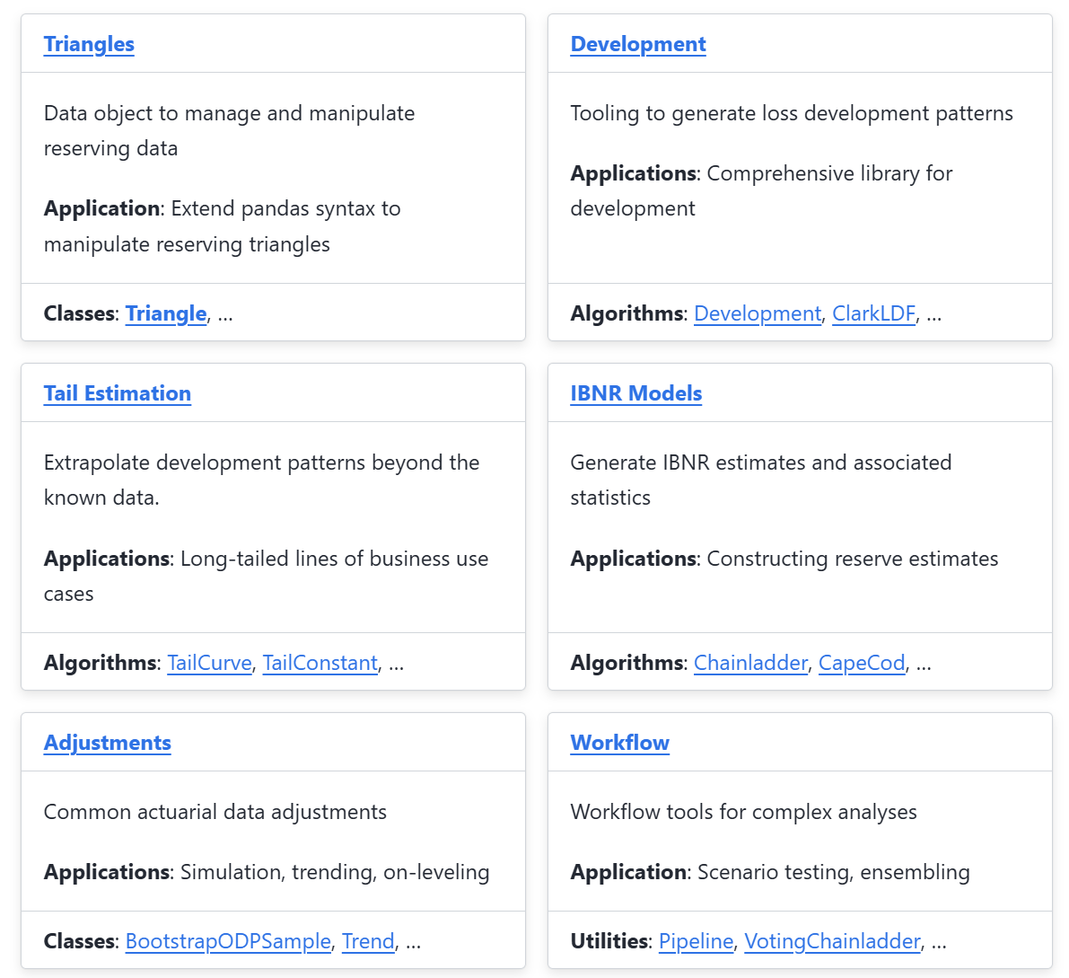
Chainladder-python
Inspired by the syntax of pandas and scikit-learn. Chainladder-python is a suite of tools to:
Managing sets of triangles
Extrapolation beyond the observed triangle
Implementation of the most widely used lag study algorithms
Common data preprocessing steps
Tools to make composite estimators

Slide 5
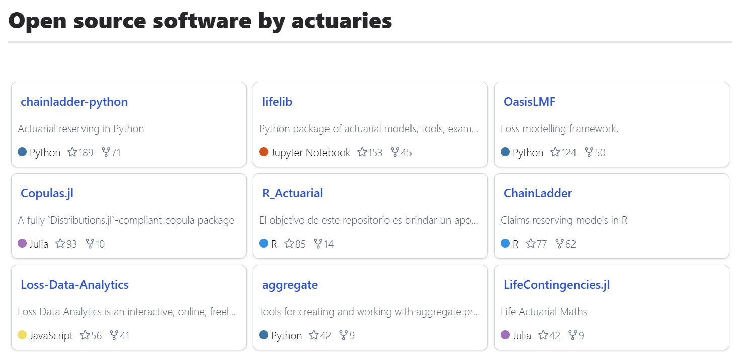
Source: www.actuarialopensource.com
Chainladder-python is currently the most popular actuarial-focused open source package as measured by github stars

Slide 6
Papers with citation of the package:
The Actuary and IBNR Techniques: A Machine Learning Approach
Ultimate Loss Reserve Forecasting Using Bidirectional LSTMs
Practitioners’ Guide to Building Actuarial Reserving Workflows Using Chain-Ladder Python

